Slide 1
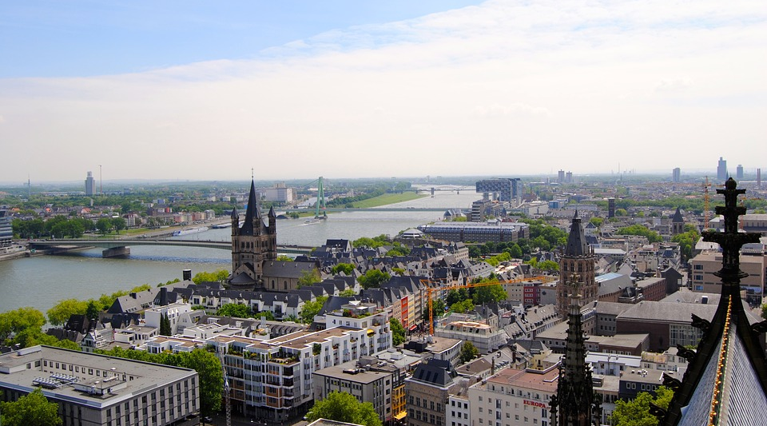
Investigation on Population Migration within Cologne

Slide 2
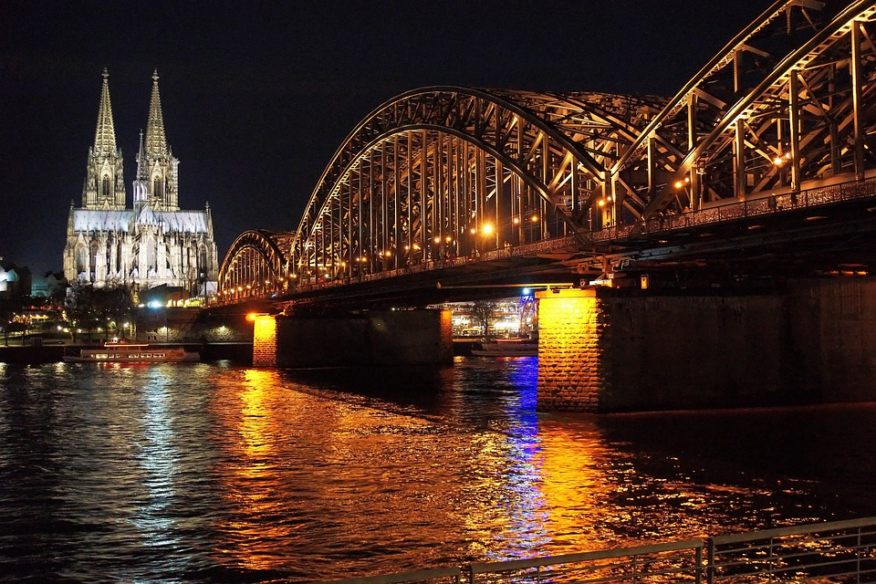
Question
Introduction
Cologne is the 4th biggest city in Germany
City seems to be very heterogeneous in culture and environment
Districts of Cologne can be seen as small sub-cities and show individual characteristics
What makes people move to other districts within Cologne?
Why are districts growing or shrinking?

Slide 3





Aspects of Living
The final target is to find districts that are growing/shrinking and to connect that to the districts’ characteristics
We will use the following aspects to characterize districts:
Location
Land Use
Age Distribution
Household Size
Migration
Venues Nearby
Land Utilization around the district
Distribution of ages within the district
Ratio of people living in households with x other people
Net migration within districts in Cologne

Slide 4
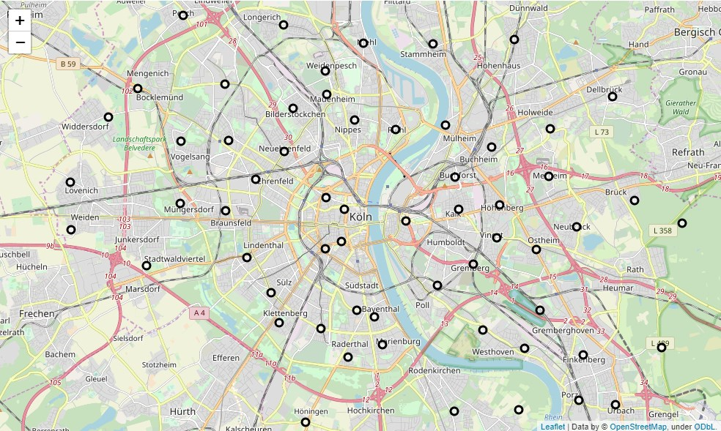
Venue Environment
Cologne can be sub-divided into several districts:

Slide 5
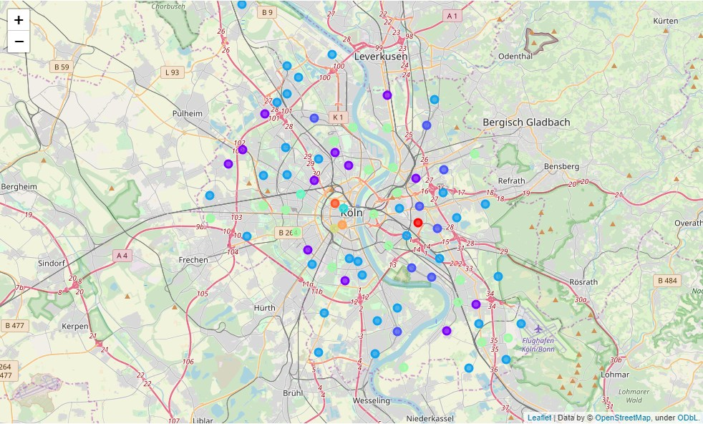
Venue Environment
Cluster analysis based on the venue environment (districts with similar venue environment show same color):

Slide 6
Venue Environment
Cluster analysis based on the venue environment (districts with similar venue environment show same color):
City center the venue distribution is very heterogeneous
Towards outer rings, we see more similarities between districts
districts close to but right of the Rhein river quite similar
similarities to clusters on the left side of the river, as it’s industry governed

Slide 7
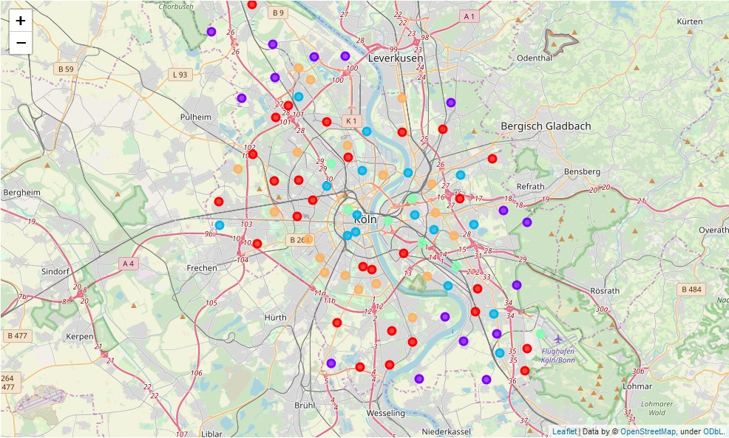
Land Utilization
Cluster analysis based on the land use (districts with similar venue environment show same color):

Slide 8
Land Utilization
Cluster analysis based on the land use (districts with similar venue environment show same color):
Areas which are close to rivers belong to one cluster category
clusters are ring-shaped with their common center being the city center
built-up areas and traffic decreases radially

Slide 9
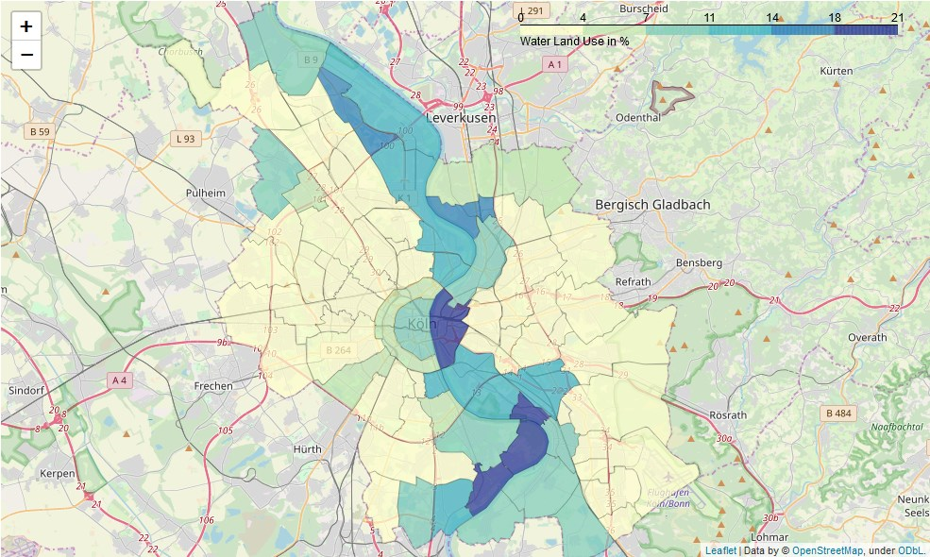
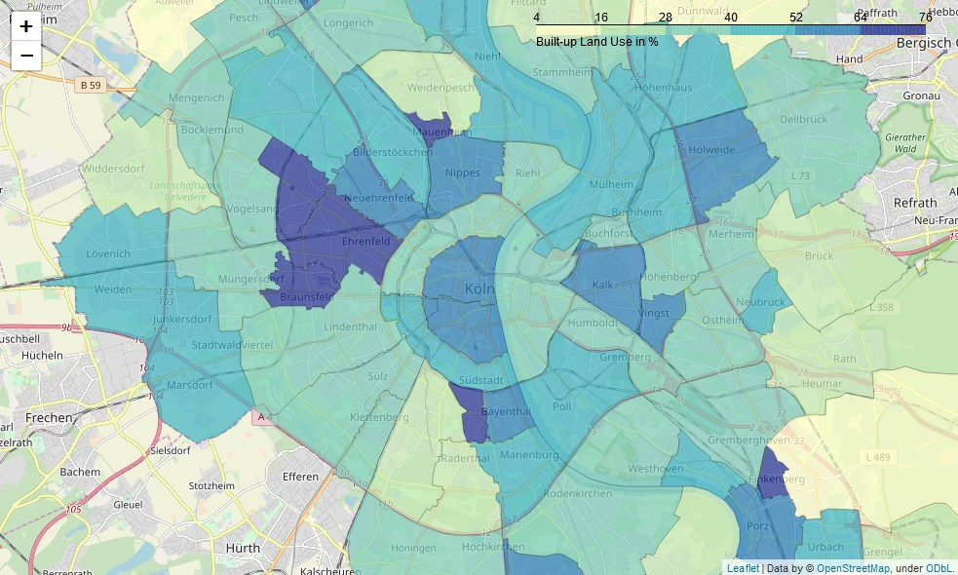
Land Utilization
Land Use Choropleth maps for water and build-up match the cluster distribution:
Water Land Use
Build-Up Land Use

Slide 10
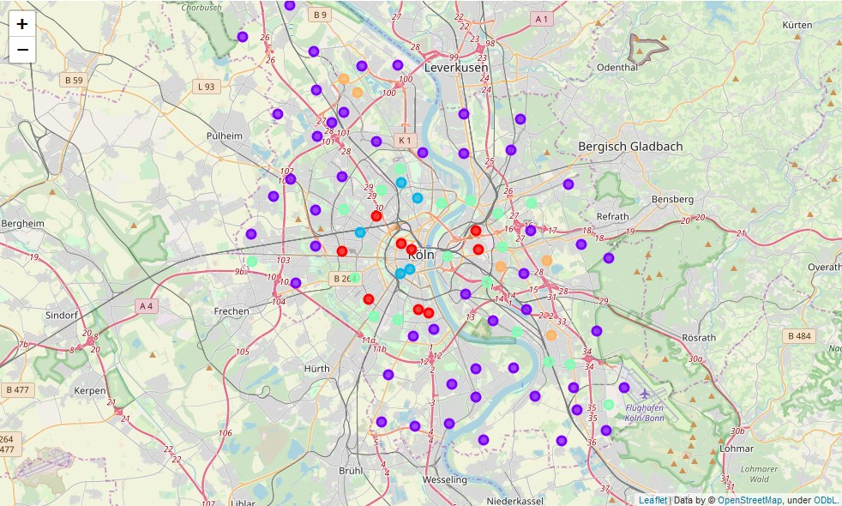
Household Sizes
Cluster analysis based on household size (districts with similar venue environment show same color):

Slide 11
Household Sizes
Cluster analysis based on household size (districts with similar venue environment show same color):
one cluster which contains the outer areas of Cologne:
→ household distribution is rather equal. This speaks for larger families living in these areas
ratio-1P 38.726531
ratio-2P 31.510204
ratio-3P 14.404082
ratio-4P 10.777551
ratio-5P+ 4.581633

Slide 12
Household Sizes
Cluster analysis based on household size (districts with similar venue environment show same color):
households near the city center
More people in single-person households
ratio-1P 61.86
ratio-2P 22.50
ratio-3P 8.32
ratio-4P 5.44
ratio-5P+ 1.88

Slide 13
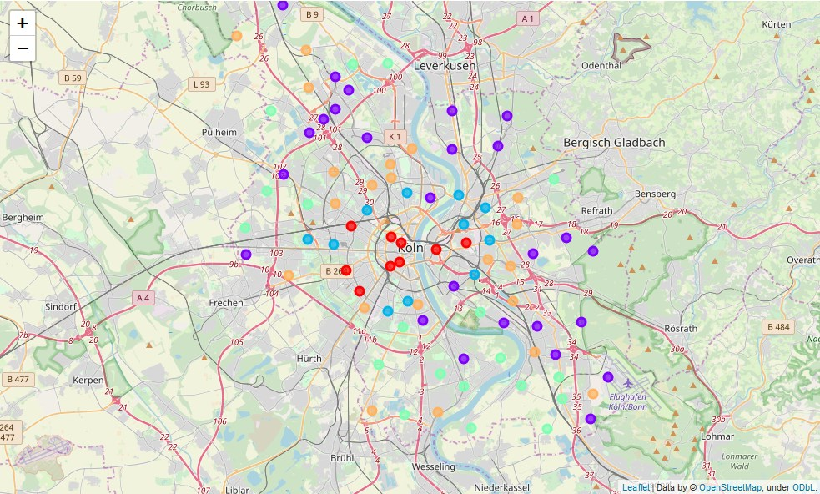
Age Distribution
Cluster analysis based on age distribution (districts with similar venue environment show same color):

Slide 14
Age Distribution
Cluster analysis based on age distribution (districts with similar venue environment show same color):
radial clustering
all the districts in the center of Cologne (horizontal center) are in the same cluster class
Center: people in working age
Older people or who want to raise children move more to the outer districts

Slide 15
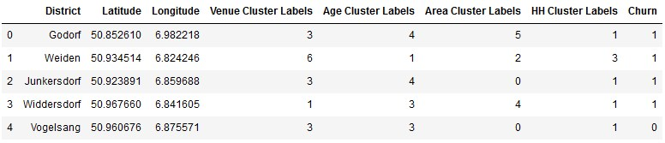
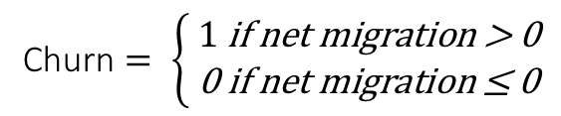
Investigating net Migration
After characterization of districts: how is their impact on net migration?
$$\text{Churn}= \left\{ \begin{aligned}&1 \text{if} \text{net} \text{migration}\text{ > 0} \\ &\text{0 }\text{if} \text{net} \text{migration}\text{ ≤ 0}\end{aligned}\right.$$

Slide 16
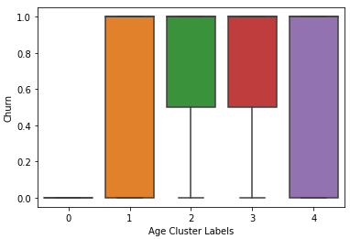
Investigating net Migration
Age Distribution Impact:
City center cluster labels have a shrinking population
costs of living high
high ratio of younger people living in 1Person households
Family founders will move to outer district

Slide 17
Conclusion
→ biggest impact on the growth of a district was given by the age distribution of the district
A negative net migration can be associated to districts with younger (pre-family-founding) persons
positive net migration can be found in districts with older age distributions
In shrinking districts, there is a vast majority of people living in single person households.
As soon as people decide to found a family, they will move to the outer districts of Cologne, where the costs of living are lower whereas people already living there, will stay. This leads to a growth of the outer districts of Cologne and a negative net migration of people in the inner districts of Cologne.

